Slide 1
Basic C# & UI

Slide 2
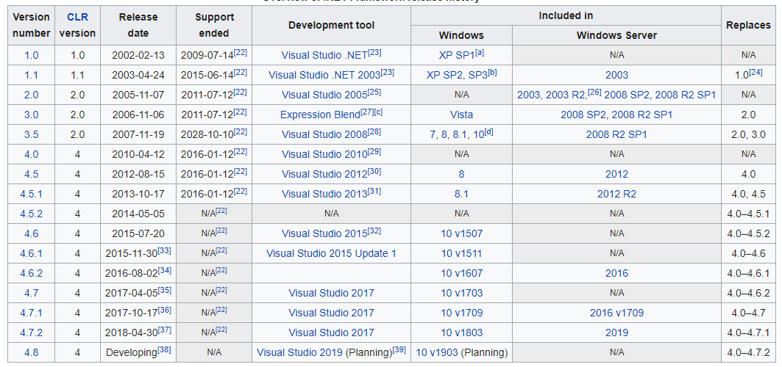
.Net framework
Software framework by Microsoft
From Wikipedia, last update: Feb 2019

Slide 3
Things to look forward
.Net 5
UWP: Universal Windows Platform
MAUI (.Net 6)
SwiftUI (Apple) → Jetpack Compose (Android)
React (FB)

Slide 4
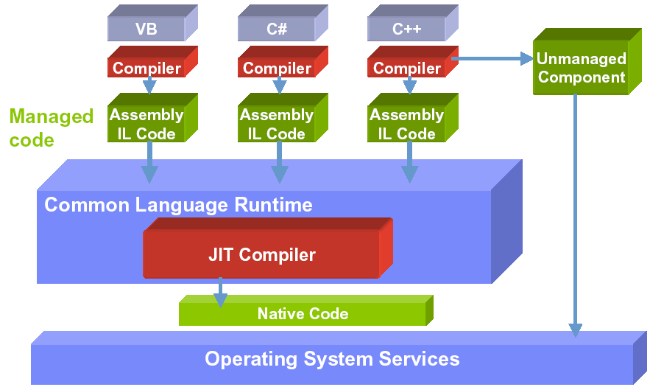
Mechanism

Slide 5
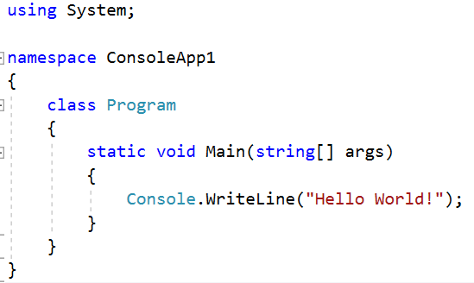

Hello world
Create a new console app

Slide 6
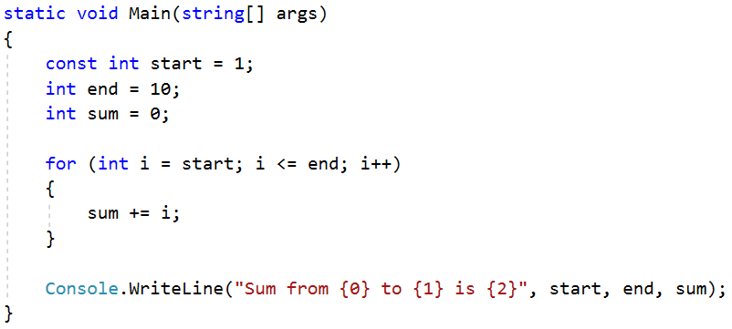

Constants & Variables
Write a program that calculate sum from 1 to 10

Slide 7
Artifact
Build => Error
Run vs Run without debugging
Release
Debug
Breakpoint & watch
Step in & Step over
Watch
Set as startup project
Open project location

Slide 8
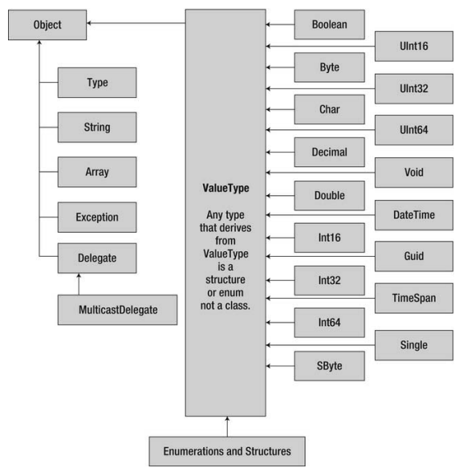
Types

Slide 9
Messing around
Position of parameter for string format
Function examples

Slide 10
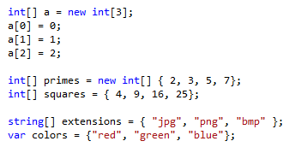
Array

Slide 11
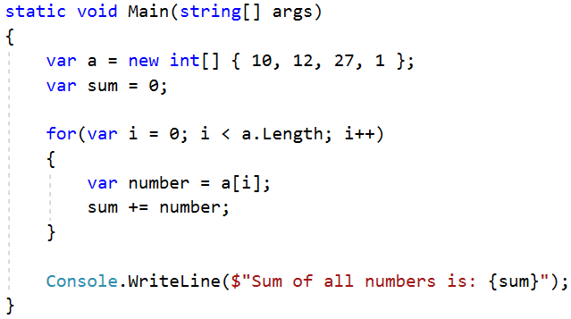


Loop through an array

Slide 12
Number casting
// Smalle to big -> OK
byte b = 5; // implicit int to byte
int i = b; // i = 5
// Big to small -> NOT OK
int i = 500;
byte j = i; // compile error
byte j = (byte)i; // i = 244

Slide 13
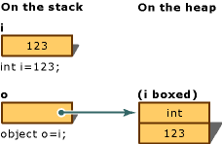
Boxing / Unboxing
Boxing: convert value type to object
Unboxing: extract value type from object

Slide 14
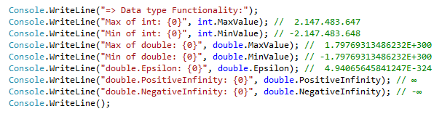
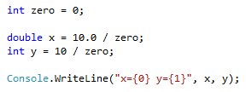
Minimum & maximum value
Result?
Notes:
Số nguyên chia cho 0 thì văng exception
Số thực chia cho 0 thì ra infinity :v

Slide 15
Operation 1/2
References: . () [] new ->
Arithmetic: + ++ - -- * / % sizeof
Logical: & | ^ !
Conditional: && (&) || ! == != > >= < <=
Type verification: is as typeof
Bitwise: ~ >> <<
Assignment: = += -= *= /= %= &= |= ^= >>= <<=
Selection: ?: ?? (not null)
Lambda expression definition: =>

Slide 16
Operation 2/2
int i = 5;
// Selection ?:
string x = i == 5 ? "Yes": "No";
int? x = 5; // nullable type
int y = x ?? 0; // Selection ?? operator
int z = x; // Error: nullable type
// cannot assign to non-nullable type
// Lambda expression – anonymous method
(int x) => x * 2; <=>
public int Double(int x){return x * 2}

Slide 17
String Format
string header = String.Format(
"{0,-12}{1,8}{2,12}{1,8}{2,12}{3,14}\n", // pattern string
"City", "Year", "Population", "Change (%)"); // argument list
string body = String.Format(
"{0,-12}{1,8:yyyy}{2,12:N0}{3,8:yyyy}{4,12:N0}{5,14:P1}",
Name, BaseYear, BasePopulation, ObserveYear, ObservePopulation,
ObservePopulation – BasePopulation)/ (double) BasePopulation);
// Sample output
City Year Population Year Population Change (%)
------------------------------------------------------------------
Los Angeles 1940 1,504,277 1950 1,970,358 31.0 %
New York 1940 7,454,995 1950 7,891,957 5.9 %
Chicago 1940 3,396,808 1950 3,620,962 6.6 %
Detroit 1940 1,623,452 1950 1,849,568 13.9 %
string s = $"{x} - {y}";

Slide 18


String concatenation
Use “+” character
Use StringBuilder
Question: what should we use, + or StringBuilder?

Slide 19
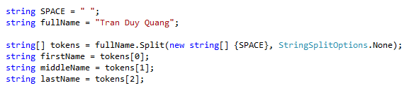
String Split
Exercise
Calculate sum of string numbers = “5, 3, 8, 11, -12, 3”
Split String fraction = “3/4” into int numerator and denominator
What if we meet 3//4?

Slide 20

String format
Positive: right align, negative: left align

Slide 21
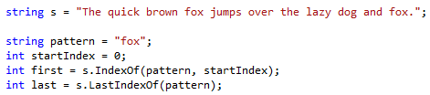
String search
Exercise
Given string s = “She sells seashells by the seashore. The shells she sells are seashells”
Calculate the number of occurrence of the word “sells” and “she”
Further reading: replace and regular expression

Slide 22
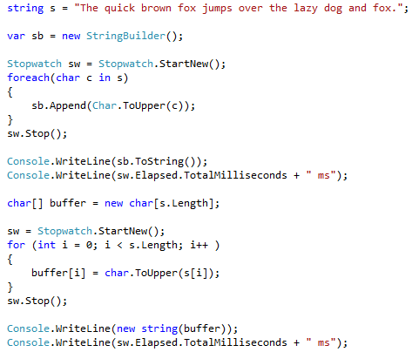

String as char array
Faster!

Slide 23
String Exercises
1. Read a string and give statistics about the number of occurrence for each of the word in the string.
2. Normalize a string of full name and print out on the screen: no more than one spaces between words, the first letter is capitalized meanwhile the rest are in lower case, no space in the beginning and the end of the string.
3. Split String fullpath = “C:\Documents\Photos\Test.jpg” into a) Containing directory b) File name c) Extension

Slide 24
DateTime
using System;
DateTime a = new DateTime();
// Full construction
DateTime b = new DateTime(2013, 06, 15, 15, 28, 31, 927);
// Current time
DateTime c = DateTime.Now;

Slide 25
Flow control
Branching
Selection: ?: ??
if… else if … else
switch … case … default
Iteration
for
foreach
do while
while
Ignore & breaking
continue
break

Slide 26
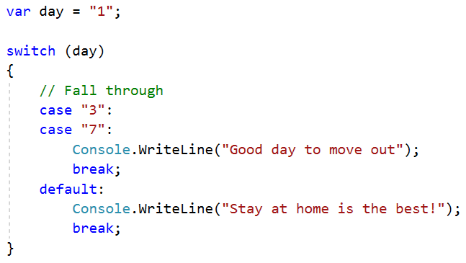
switch case example

Slide 27
Function parameters
ref
out

Slide 28
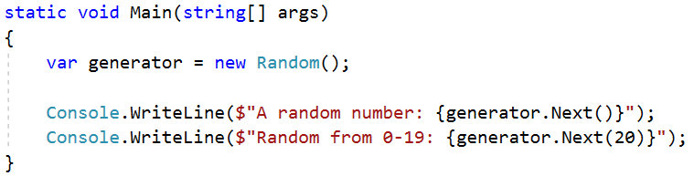
Random generator

Slide 29
Basic coding convention

Slide 30
if for do while
Add an empty line before and after
Always use brackets even if there is one line of code

Slide 31
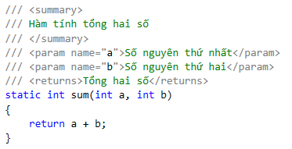
Comment
Should provide purpose of a block of function
XML comment for document generation (doxygen)

Slide 32
Function name
Start with a verb
Private: camelCase
Public: PascalCase
Ex: isPrime, doSomething
Quiz: Check if a element exists in an array

Slide 33
Constants
PascalCase

Slide 34
Exercises
Check if a number is a prime number
bool IsPrime(int number) / LaSoNguyenTo()
Calculate x^{n}
double Pow(double x, int n) / LuyThua

Slide 35
Exercises
Given a valid date in 3 variables: day, month, year
Write a function that print out the next day

Slide 36
Basic UI

Slide 37
WPF
Create WPF app
UI is written in xaml language
Code behind is C#

Slide 38
4 basic controls
Label
TextBox
Button (Click event)
Image
MessageBox

Slide 39
Homework
1. Hiển thị ngẫu nhiên một câu trích dẫn tạo động lực kèm hình (chọn từ tối thiểu mảng 10 phần tử). Ví dụ: "Không có gì là không thể". Nguồn: https://motivationping.com/quotes/
2. Hiển thị ngẫu nhiên một cặp hình & từ tiếng Anh (chủ đề từ chọn, ví dụ: Động vật, chọn từ tối thiểu mảng 10 phần tử)

